Slide 1
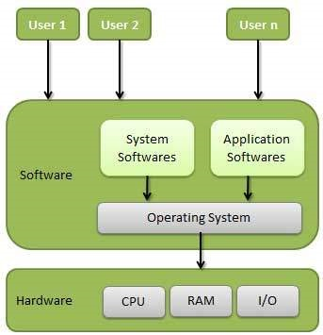
INTRODUCTION TO OS

Slide 2
CLASSIFICATION OF OPERATING SYSTEM
Multi-user OS : Allows two or more users to run programs at the same time.
Multiprocessing OS : Support a program to run on more than one central processing unit (CPU) at a time.
Multitasking OS : Allows to run more than one program at a time
Multithreading OS : Allows different parts of a single program to run concurrently (simultaneously or at the same time).
Real time OS : These are designed to allow computers to process and respond to input instantly

Slide 3
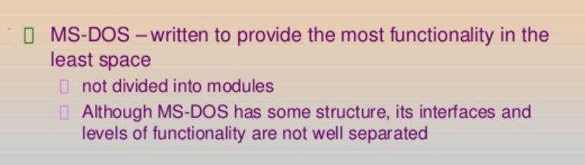
OPERATING SYSTEM STRUCTURES
A SIMPLE STRUCTURE: There are many operating systems that have a rather simple structure.
These started as small systems and rapidly expanded much further than their scope. A common example of this is MS-DOS.
MS – DOS SYSTEM STRUCTURE

Slide 4
MS – DOS Structure
For efficient performance and implementation an OS should be partitioned into separate subsystems, each with carefully defined tasks, inputs, outputs, and performance characteristics.
Application Programming
Resident System Programming
MS-DOS Drivers
ROM - BIOS Device Drivers

Slide 5
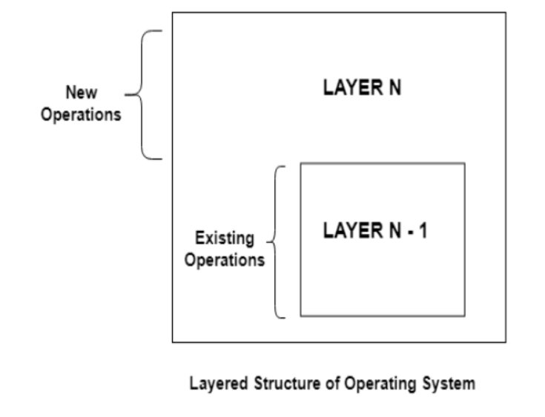
LAYERED STRUCTURE
One way to achieve modularity in the operating system is the layered approach. It breaks the OS into a number of smaller layers, each of which rests on the layer below it, and relies solely on the services provided by the next lower layer.

Slide 6
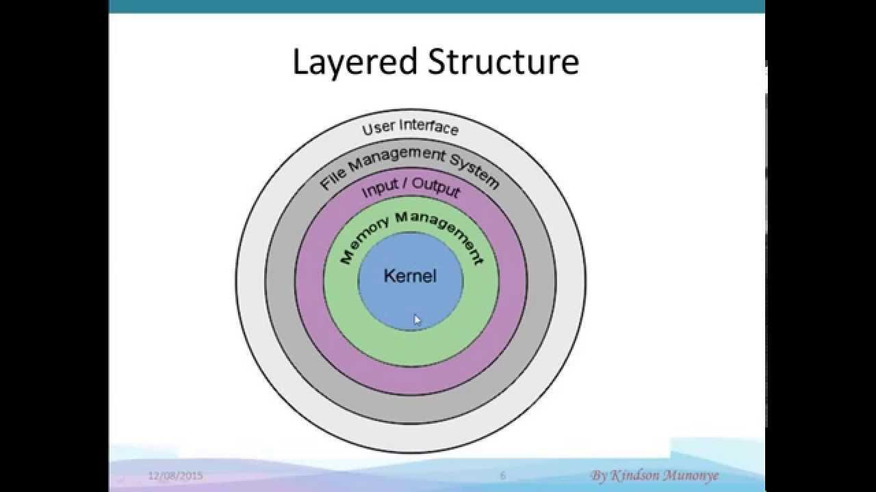

Slide 7
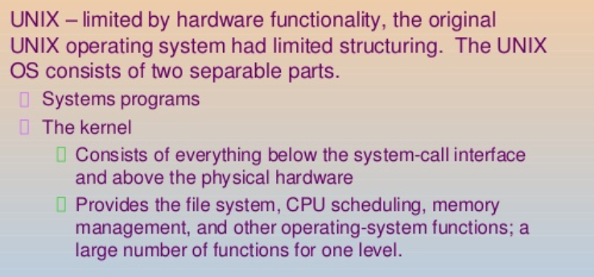
UNIX STRUCTURE

Slide 8
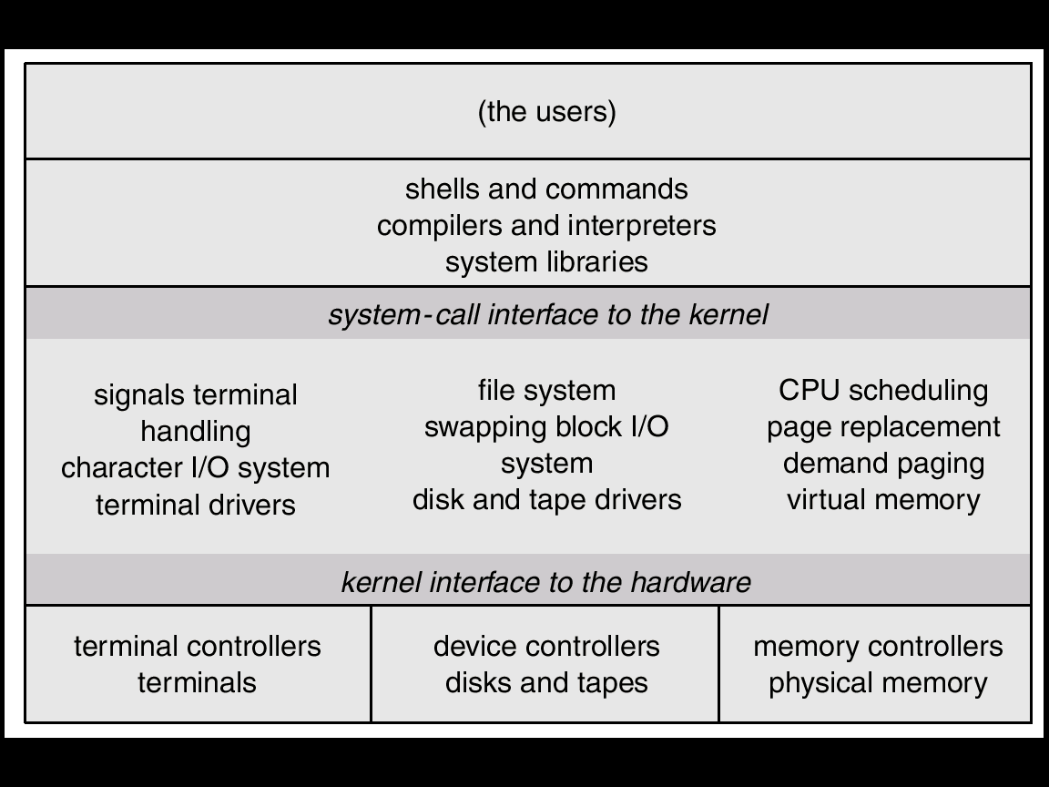
UNIX

